Slide 1
Hardware Acceleration of Neural Graphics
Electrical & Computer Engineering
Muhammad Husnain Mubarik (UIUC),
Ramakrishna Kanungo (UIUC), Tobias Zirr (Intel), Rakesh Kumar (UIUC)
06/19/2023
Notes:
Hello Everyone, thank you for attending our presentation on hardware acceleration of neural graphics
My name is Muhammad Husnain Mubarik and this work has been done in collaboration with Ramakrishna Kanungo from UIUC, Tobias Zirr from intel and professor Rakesh Kumar from UIUC

Slide 2
Conventional Computer Graphics
Fundamental Objective of Computer Graphics: Synthesize photo-realistic and controllable imagery.
ELECTRICAL & COMPUTER ENGINEERING
GRAINGER ENGINEERING
Notes:
The fundamental objective of CG is to generate photo-realistic and controllable imagery.
Conventional computer graphics rely on predefined algorithms and rules, to create and manipulate visual content.
Rendering in conventional computer graphics starts with the detailed description of the physical and material properties of the scene.
This description is passed as input to multiple fixed function and programmable stages of the rendering pipeline, which then generates 2D images as output.

Slide 3
Challenges of Conventional Computer Graphics
Challenges:
Rendering and inverse rendering algorithms are computationally demanding.
Inefficient memory utilization, complex data structures, non-deterministic rendering time, detailed scene descriptions.
ELECTRICAL & COMPUTER ENGINEERING
GRAINGER ENGINEERING
Notes:
Rendering and inverse rendering algorithms in conventional computer graphics pose significant computational challenges.
For example, Storing discrete samples of continuous functions in memory is inefficient and requires a large memory footprint.
Complex data structures are utilized for 3D representation, which are dependent on the scene geometry.
Rendering time is non-deterministic and is heavily influenced by the complexity of the scene.
Moreover, A detailed description of the scene is required for image synthesis

Slide 4
What is Neural Graphics?
Assumption: Neural networks can potentially approximate algorithms used in classical computer graphics.
Neural graphics: Approximating entire or parts of computer graphics using neural networks.
ELECTRICAL & COMPUTER ENGINEERING
GRAINGER ENGINEERING
Notes:
Neural graphics aims to tackle the computational challenges posed by rendering and inverse rendering algorithms.
In NG, NNs are used to approximate entire or part of the CG algorithms.
It replaces the conventional rendering pipeline with a much simpler neural rendering pipeline.
The geometric and material properties of the scene are derived from multiple scene observations which serves as an input to the neural rendering pipeline.
At a high level, the pipeline comprises an input generation and encoding stage, a NN stage, and an output accumulation stage.

Slide 5
Why Neural Graphics?
Benefits: Compact Representations, Simpler Data Structures, Deterministic Rendering Time, Image Synthesis from Observations
ELECTRICAL & COMPUTER ENGINEERING
GRAINGER ENGINEERING
Notes:
NG offers several benefits over conventional computer graphics
It offers more compact representations of scenes, in the form of neural network parameters,
Simpler data structures are used for scene representation which are usually scene geometry agnostic.
NG also offers a relatively deterministic rendering time since a significant portion of the rendering process is replaced with constant-cost inference operations.
Moreover, NG offers the ability to synthesize images from a few observations of the scene.
Now, let's explore the various stages of the neural graphics pipeline.

Slide 6
Structure of a Typical Neural Graphics Application
Input Stage
Multi-resolution Hashgrid Encoding
Neural Network Stage
Multilayer Perceptron (MLP)
Output Stage
Accumulation of pixel colors and densities
Multi-Resolution Densegrid Encoding
Low-resolution Densegrid Encoding
ELECTRICAL & COMPUTER ENGINEERING
GRAINGER ENGINEERING
Notes:
A typical NG application consists of 3 stages, an input stage, NN stage and an output stage,
In the Input stage a mapping function is used to map the input vectors to a higher dimensional space. The mapping function can either be a fixed high-frequency function or a learn-able function. Based on the choice of the mapping function, the input encoding schemes can be categorized into two main categories: fixed-function encodings and parametric encodings.
To effectively capture the high-frequency information in the visual data, an input encoding kernel is employed.
During our study, we focused on three representative input encoding algorithms: Multi-resolution Hashgrid encoding, Multi-resolution Densegrid encoding, and Low-resolution Densegrid encoding.
The NN stage consists of a MLP which is responsible for learning the representation of the scene.
The output stage is responsible for the accumulation of the pixel colors and densities and generate the final 2D output frame.

Slide 7
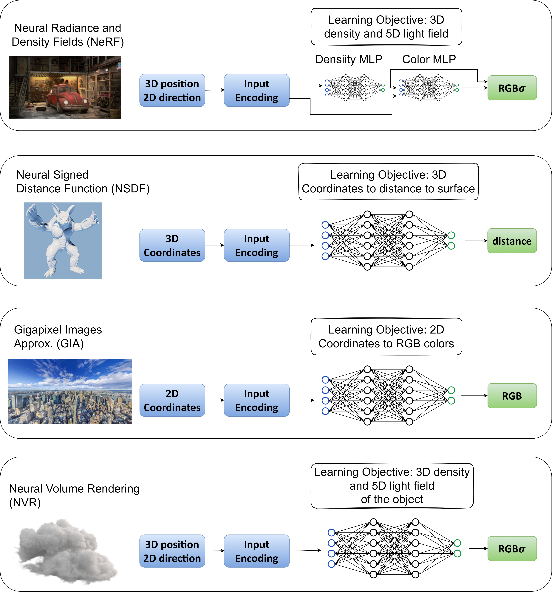
Representative Neural Graphics Applications
Neural radiance and density fields (NeRF)
Neural signed distance functions (NSDF)
Gigapixel image approximation (GIA)
Neural volume rendering (NVR)
ELECTRICAL & COMPUTER ENGINEERING
GRAINGER ENGINEERING
Notes:
We studied four representative neural graphics applications. The applications we studied are NeRF, NSDF, GIA and NVR
In NeRF, two fully-connected neural networks, Density MLP and Color MLP, are used to learn the 3D density and 5D light field of a scene from limited scene observations. As the density information of a scene is view direction agnostic, the encoded camera coordinates are used as input to the density MLP. As the color information depends upon position as well as view angle, the output of the density MLP along with the encoded view directions are passed as input to the color MLP. The output of the color and density MLP are concatenated together to get the four dimensional vector containing the pixel color and the density information.
Moving on to NSDF, it addresses the task of approximating signed distance functions that are commonly used in classical computer graphics to represent 3D shapes. Here, an MLP is trained to map 3D coordinates to surface distances. The inputs to the MLP are encoded positions, and the final output is the distance to the surface.
GIA employs a neural network to learn gigapixel images by mapping 2D coordinates to RGB colors.
NVR is similar to NeRF but learns density and reflectance fields for simulating light transport in volumes.

Slide 8
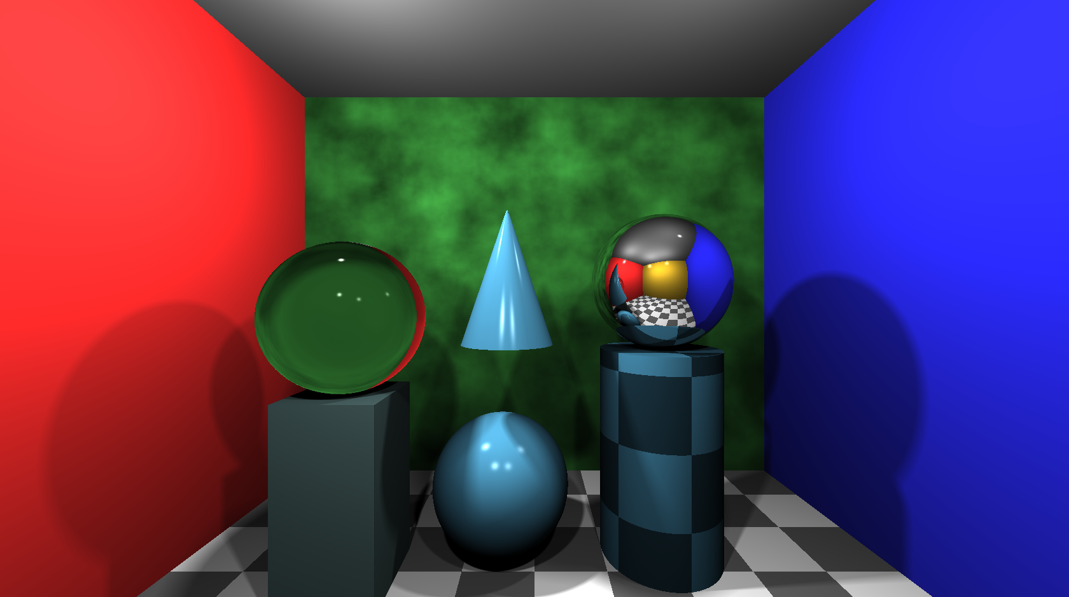
Does Neural Graphics Need Hardware Support?
ELECTRICAL & COMPUTER ENGINEERING
GRAINGER ENGINEERING
Notes:
In this study we addressed the question, does NG need HW support?

Slide 9
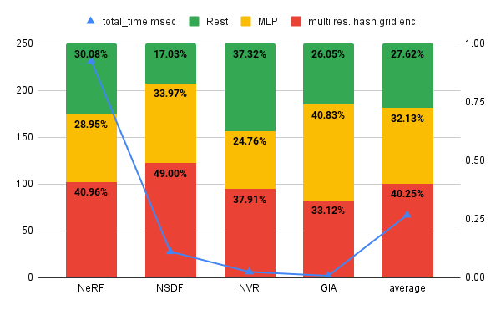
Profiling Neural Graphics Applications on a GPU
Rendering 2k resolution frames on RTX3090 takes 100s of milli seconds
Where are those 100s of milli seconds going?
MLP + Multi Res. Hash Grid – 72 %
ELECTRICAL & COMPUTER ENGINEERING
GRAINGER ENGINEERING
Notes:
To understand the performance aspects of NG, we profiled these applications on a GPU. Our profiling shows that rendering high-resolution frames on powerful GPUs like the RTX3090 can still take several hundred milliseconds.
By analyzing the kernel-level performance breakdown, we can identify the main areas where these milliseconds are spent.
Our analysis shows that the MLP and input encoding kernels account for 72% of compute cycles. Hence it makes sense to accelerate these kernels.

Slide 10
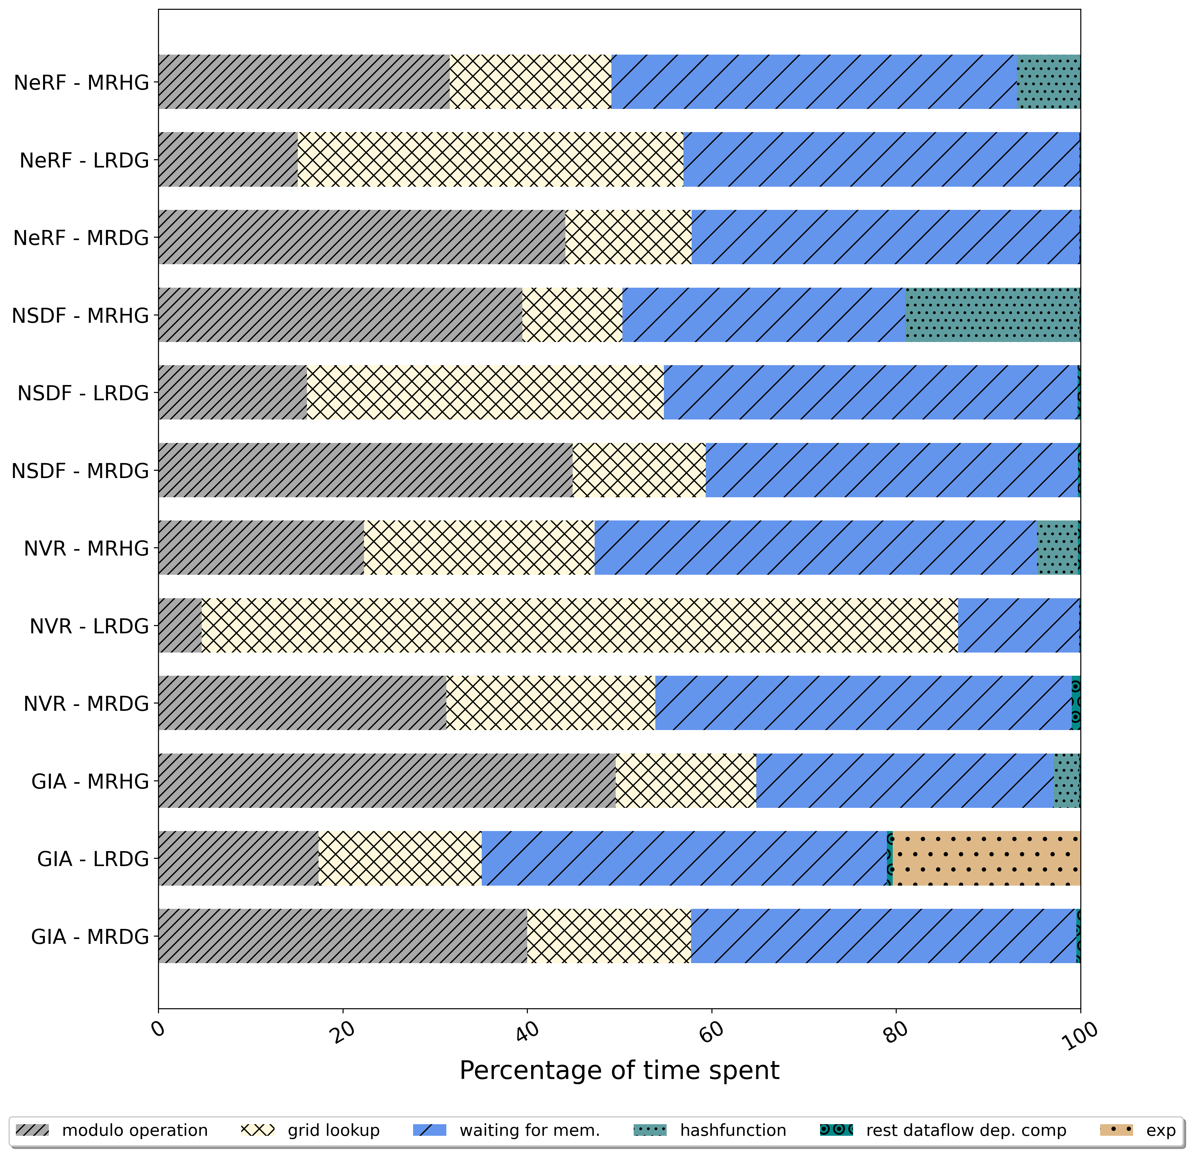
Profiling Neural Graphics Applications on a GPU
Operation level breakdown of grid encoding kernels
Grid Lookup
Modulo Operation
Exponent
Rest dataflow dependent compute
Waiting for memory
Hash function
ELECTRICAL & COMPUTER ENGINEERING
GRAINGER ENGINEERING
Notes:
We performed further analysis to understand the performance bottlenecks in the input encoding kernel.
We identified the most expensive operations in terms of number of cycles spent for different encoding types.
Our analysis shows that the grid lookups are the major building block of the input encoding algorithms that take significant amount of cycles across all three input encoding types.
The other expensive operations include the hash function, the integer mapped modulo operation and the exponent operation.
Furthermore, the overall cycle count was influenced by the dataflow-dependent computations within the input encoding algorithm and the time spent waiting for memory to resolve cache misses.
We utilized these observations to guide our design decisions regarding the hardware accelerator for input encoding.

Slide 11
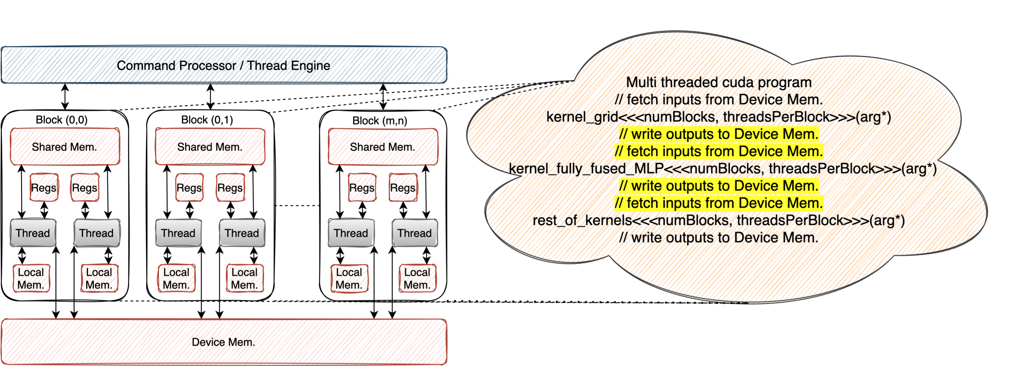
Scheduling of a Neural Graphics Application on a GPU
MLP and encoding kernels have unnecessary memory ping pong.
ELECTRICAL & COMPUTER ENGINEERING
GRAINGER ENGINEERING
Notes:
Our analysis further shows that the IE and MLP kernels have unnecessary memory ping pong on GPU. The IE kernel writes it’s outputs to main memory which are then fetched by the MLP kernel as input feature maps. As an MLP kernel always works on the outputs of IE kernel, this unnecessary memory traffic can be avoided by directly sending the outputs of IE kernel to the MLP kernel.

Slide 12
Neural Graphics Processing Cluster (NGPC)
ELECTRICAL & COMPUTER ENGINEERING
GRAINGER ENGINEERING
Notes:
To address the performance challenges, we introduce the NGPC, a hardware solution designed specifically for accelerating the input encoding and MLP kernels.

Slide 13
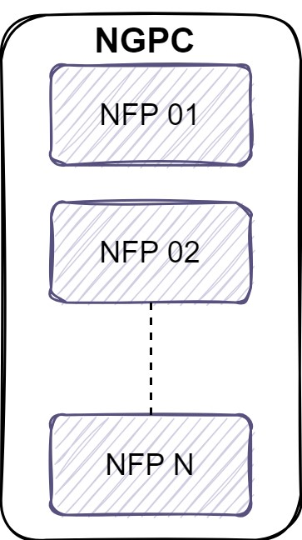
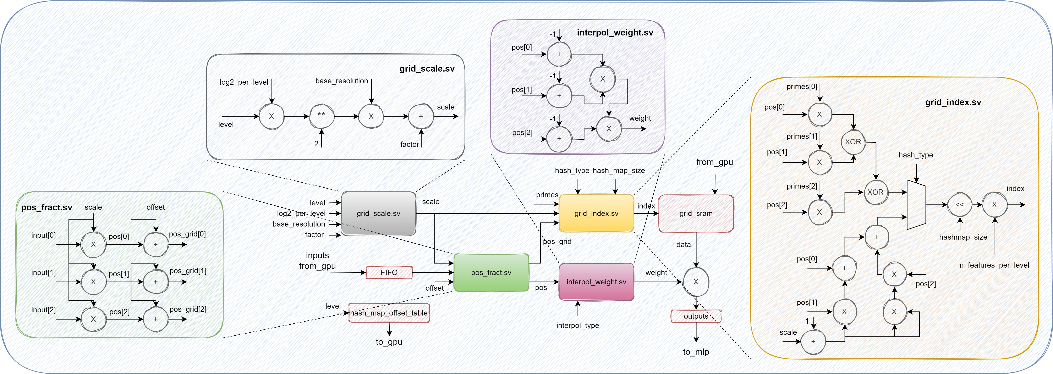
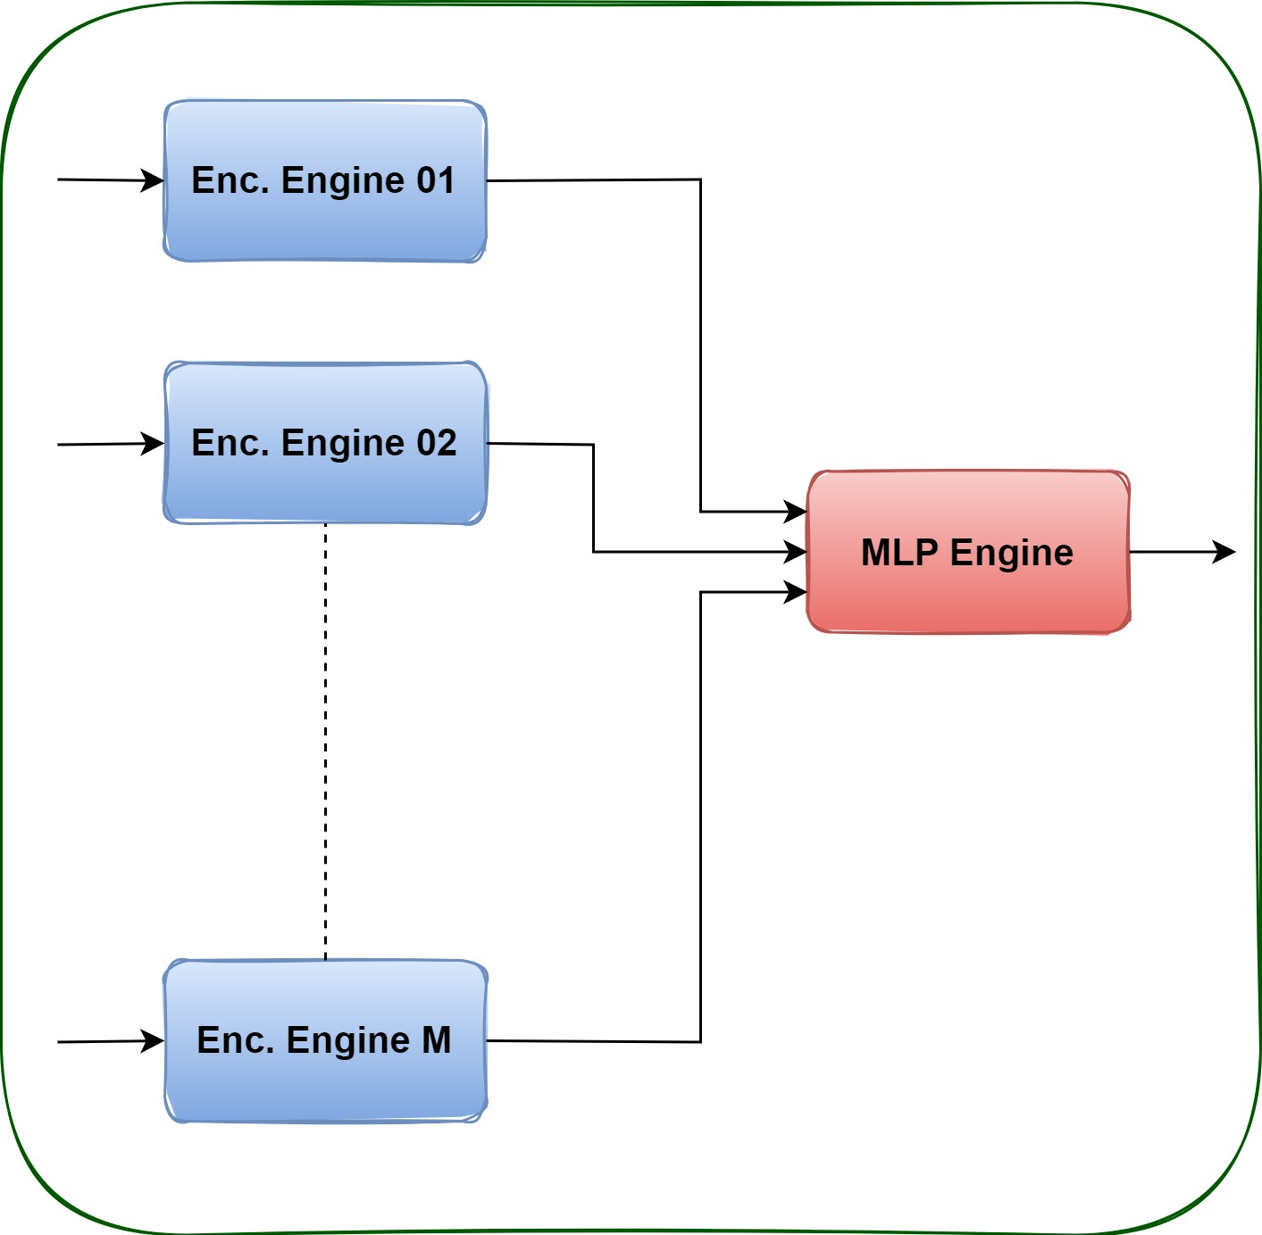
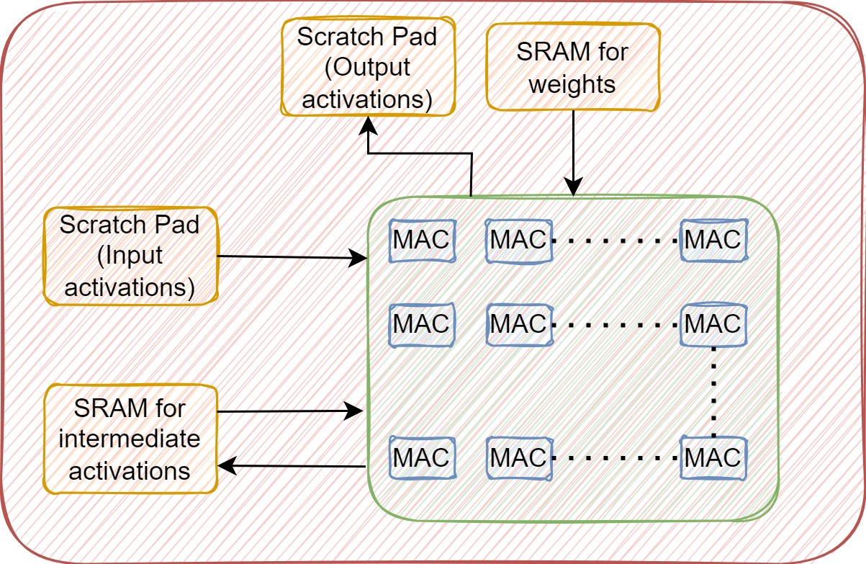
Architecture of the Neural Graphics Processing Cluster (NGPC)
ELECTRICAL & COMPUTER ENGINEERING
GRAINGER ENGINEERING
Notes:
NGPC consists of N neural fields processors, where N can be selected as 8, 16, 32 or 64 depending upon the desired performance requirements and the overall area, power constraints.
Since our profiling motivates the need to accelerate the input encoding and MLP kernels, we designed the
neural fields processor – which accelerates these two kernels in hardware using separate hardware-engines for the two.
NFP has 16 encoding engines to match the maximum number of resolution-levels of the neural-graphics applications and a dedicated MLP engine.
To accelerate input encoding kernel, our kernel level analysis suggests providing hardware support for the grid lookups and the dataflow of the input encoding.
Each encoding engine has a dedicated on-chip SRAM to cache the encoding parameters and the dataflow of the IE kernel is hardcoded in the encoding engine.
The encoding engine writes its outputs directly to the MLP engine to avoid unnecessary off-chip memory traffic.

Slide 14
Interaction of the NGPC with GPU
ELECTRICAL & COMPUTER ENGINEERING
GRAINGER ENGINEERING
Notes:
The NGPC is connected to the shared L2 cache of the GPU
The programming model for the NGPC involves, the GPU command buffer configuring the NGPC and scheduling the input encoding and the MLP kernels on the NGPC. The rest of the kernels are scheduled just as conventional CUDA kernels on the streaming multiprocessors of GPU.
The outputs of the NGPC are written back to the GPU memory, and are read by the streaming multiprocessors, which then compute the rest of the kernels.

Slide 15
Analytical model to estimate the performance, power and area of NGPC
Inputs
The NG application parameters such as IE type, IE parameters, MLP parameters etc
The NGPC architecture parameters such as num. of NFPs, fmax, mem access time, synthesized area power estimates of modules
Kernel level performance breakdown of NG application on a GPU
Outputs
The overall performance of the NG application with the IE and the MLP scheduled on NGPC and the rest of the kernels scheduled on the GPU.
The overall area and power of the NGPC.
Analytical Model
ELECTRICAL & COMPUTER ENGINEERING
GRAINGER ENGINEERING
Notes:
In order to estimate the performance of NG applications on RTX3090-augmented with NGPC and the corresponding power and area impact of NGPC, we developed an analytical model,
The inputs to our model are parameters of neural graphics applications, the architectural parameters of NGPC, the kernel level performance breakdown of our applications on GPU.
And the outputs are the overall performance of the NG application with IE and MLP scheduled on NGPC and the rest of the kernels scheduled on the SMs of the GPU.

Slide 16
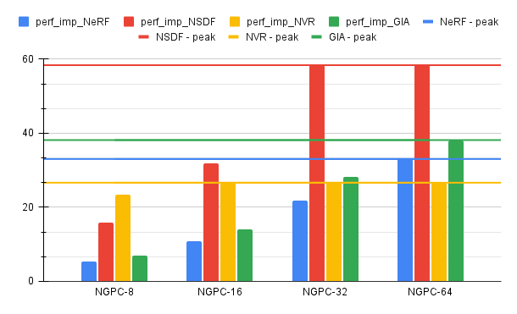
Performance of Neural Graphics Applications with NGPC
Multi Res. Hash Grid
08 NFPs – 13X
16 NFPs – 21X
32 NFPs – 34X
64 NFPs – 39X
ELECTRICAL & COMPUTER ENGINEERING
GRAINGER ENGINEERING
Notes:
Our results show that when we have only 8 NFP units in the NGPC, on average across all four neural graphics applications, we get overall 13× performance benefits compared to the GPU-only baseline. When we scale the number of NFP units in an NGPC to 16, 32 and 64, the performance benefits, averaged across the four representative neural graphics applications, increase to 21×, 34× and 39× respectively
Our sensitivity studies further show that for NeRF increasing the number of NFP units beyond 64 does not improve the overall performance of the application. This is because the time consumed by the non- input encoding and MLP kernels becomes the performance bottleneck.
for NSDF , NVR and GIA the performance plateaus for 32, 16 and 64 NFP units respectively.

Slide 17
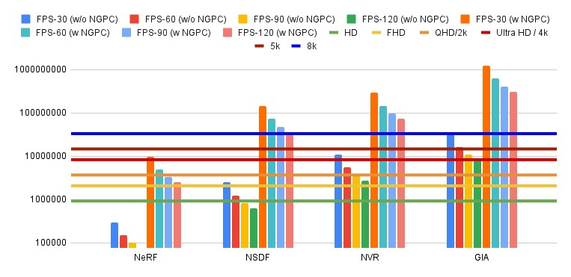
Pixels Rendered w/wo NGPC
ELECTRICAL & COMPUTER ENGINEERING
GRAINGER ENGINEERING
Notes:
Finally, let's observe the impact of NGPC on rendered pixels.
Bar graph shows the number of pixels rendered with and without NGPC, for different target frame rates.
Without NGPC rendering NeRF with 30FPS target can not even achieve HD resolution
Whereas, with NGPC, rendering NeRF at 30 FPS can reach 4k Ultra HD resolution, while the remaining three applications can achieve 8k Ultra HD resolution at 120 frames per second.

Slide 18
Summary and Conclusion
Neural graphics as a potent replacement for traditional rendering algorithms.
Disparity between desired performance and the current state of the art (1.5x-55x).
Identification of input encoding and MLP kernels as performance bottlenecks.
Proposal of NGPC – a hardware solution to accelerate input encoding and MLP.
The NGPC achieves up to 58X end-to-end application-level performance improvement.
NGPC enables rendering of 4k Ultra HD resolution frames at 30 FPS for NeRF and 8k Ultra HD frames at 120 FPS for all other neural graphics applications.
In this paper we addressed the question does NG need HW support?
ELECTRICAL & COMPUTER ENGINEERING
GRAINGER ENGINEERING
Notes:
In summary, Neural graphics promises a fast and deterministic time replacement for traditional rendering algorithms
In this paper we addressed the question does NG need HW support?
We studied four representative neural graphics applications and showed that, if we want to render 4k resolution frames at 60FPS, there is a performance gap of upto 55.50× between the desired performance and the state of the art.
We identified that the IE and the MLP kernels are the main performance bottlenecks and proposed NGPC – a hardware solution to accelerate IE and MLP
The NGPC achieves up to 58X end-to-end application-level performance improvement.
which enables rendering of 4k Ultra HD resolution frames at 30 FPS for NeRF and 8k Ultra HD frames at 120 FPS for all other neural graphics applications.

Slide 19
Thank you!
Questions!?
ELECTRICAL & COMPUTER ENGINEERING
GRAINGER ENGINEERING
Notes:
Thank you for you attention, now I’ll take the questions.

